Slide 1

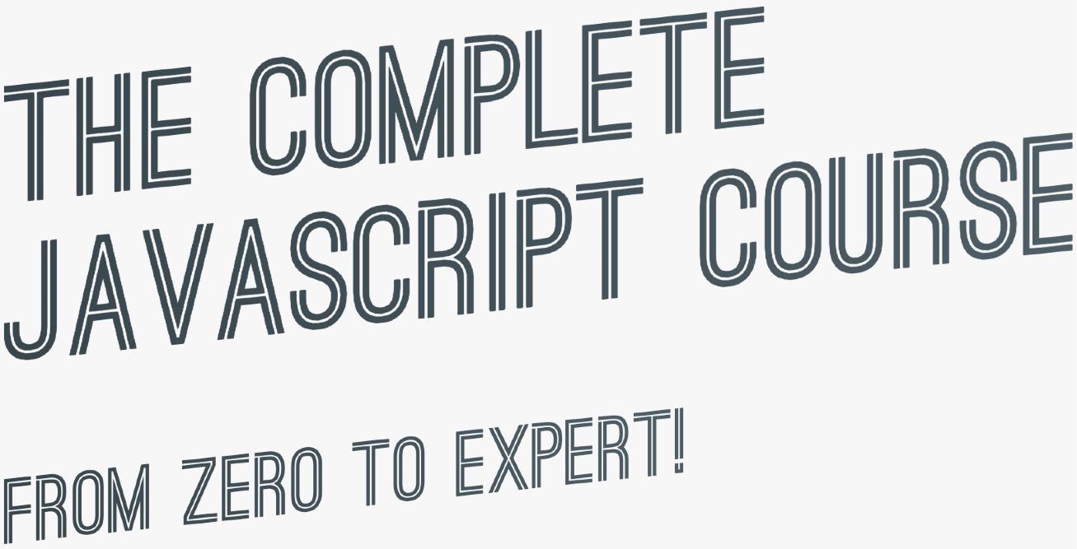

SECTION
WELCOME, WELCOME, WELCOME!

Slide 2



SOME QUICK CONSIDERATION BEFORE WE START...
You need to code along with me! You will learn ZERO JavaScript skills by just sitting and watching me code. You have to code YOURSELF!

Slide 3


SOME QUICK CONSIDERATION BEFORE WE START...
If this is your first time ever programming, please don’t get overwhelmed. It’s 100% normal that you will not understand everything at the beginning. Just don’t think “I guess coding is not for me”!

Slide 4
A BRIEF INTRODUCTION TO JAVASCRIPT

Slide 5




WHAT IS JAVASCRIPT?
We don’t have to worry about complex stuff like memory management
JAVASCRIPT
JAVASCRIPT IS A HIGH-LEVEL, OBJECT-ORIENTED, MULTI-PARADIGM PROGRAMMING LANGUAGE.
We can use different styles of programming
Based on objects, for storing most kinds of data
Instruct computer to do things

Slide 6


THE ROLE OF JAVASCRIPT IN WEB DEVELOPMENT
NOUNS
<p></p>
means “paragraph”
CONTENT
ADJECTIVES
p {color: red}
means “the paragraph text is red”
VERBS
p.hide();
means “hide the paragraph”
PRESENTATION
PROGRAMMING LANGUAGE: BUILDING WEB APPLICATIONS

Slide 7
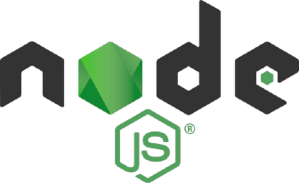





THERE IS NOTHING YOU CAN’T DO WITH JAVASCRIPT (WELL, ALMOST…)
Front-end apps
Back-end apps
Dynamic effects and web applications in the
browser
Web applications on web servers
THIS COURSE
100% based on JavaScript. They might go away, but JavaScript won’t!
Native mobile applications
Native desktop applications

Slide 8


JAVASCRIPT RELEASES... (MORE ABOUT THIS LATER)
Biggest update to the language EVER
New updates to JS every single year
ES6/ ES2015
ES7/ ES2016
ES8/ ES2017
ES9/ ES2018
ES10/ ES2019
ES11/ ES2020
...
ES5
...
Modern JavaScript
ECMAScript
Learn modern JavaScript from the beginning, but without forgetting the older parts!
Let’s finally get started!

Slide 9
Queries?

Slide 10
LETS CODE!

Slide 11
DATA TYPES

Slide 12
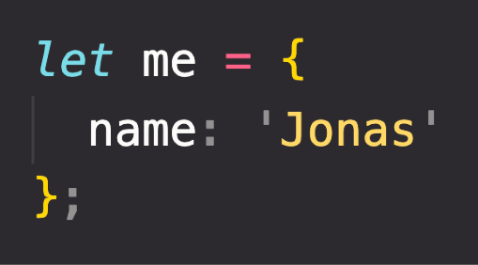
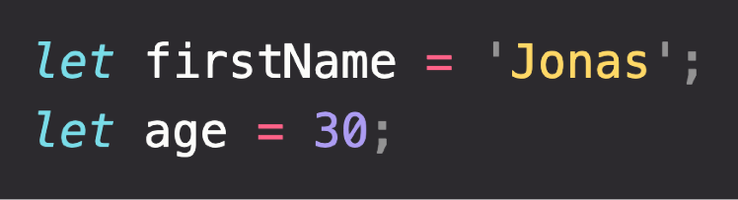
OBJECTS AND PRIMITIVES
VALUE
EVERYTHING ELSE
OBJECT
OR
PRIMITIVE

Slide 13

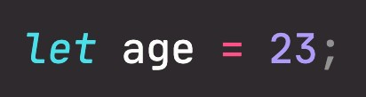

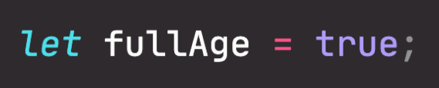
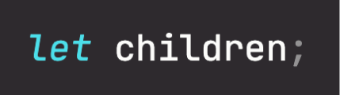

THE 7 PRIMITIVE DATA TYPES
Number: Floating point numbers
String: Sequence of characters
Used for decimals and integers
Used for text
Boolean: Logical type that can only be true or false Used for taking decisions
Undefined: Value taken by a variable that is not yet defined (‘empty value’)
Null: Also means ‘empty value’
Symbol (ES2015): Value that is unique and cannot be changed [Not useful for now]
BigInt (ES2020): Larger integers than the Number type can hold
JavaScript has dynamic typing: We do not have to manually define the data type of the value stored in a variable. Instead, data types are determined automatically.
Value has type, NOT variable!

Slide 14
BOOLEAN LOGIC

Slide 15

BASIC BOOLEAN LOGIC: THE AND, OR & NOT OPERATORS
A AND B A OR B
NOT A, NOT B
“Sarah has a driver’s license
AND good vision”
“Sarah has a driver’s license
OR good vision”
Possible values
Inverts true/false value
A
A
OR | TRUE | FALSE
TRUE | TRUE | TRUE
FALSE | TRUE | FALSE
AND TRUE
FALSE
B
TRUE
TRUE
FALSE
Results of
B
operation,
depending on
EXAMPLE:
A: Sarah has a driver’s license
B: Sarah has good vision
FALSE FALSE FALSE
2 variables
true when ALL are true
true when ONE is true
Boolean variables that can be either TRUE or FALSE
No matter how many variables

Slide 16
LETS CODE!

Slide 17
JAVASCRIPT RELEASES: ES5, ES6+ AND ESNEXT

Slide 18






A BRIEF HISTORY OF JAVASCRIPT
1995
Brendan Eich creates the very first version of JavaScript in just 10 days. It was called Mocha, but already had many fundamental features of modern JavaScript!
1996
Mocha changes to LiveScript and then to JavaScript, in order to attract Java developers. However, JavaScript has almost nothing to do with Java
Microsoft launches IE, copying JavaScript from Netscape and calling it JScript;
1997
With a need to standardize the language, ECMA releases ECMAScript 1 (ES1), the first official standard for JavaScript (ECMAScript is the standard, JavaScript the language in practice);
2009
ES5 (ECMAScript 5) is released with lots of great new features;
2015
ES6/ES2015 (ECMAScript 2015) was released: the biggest update to the language ever!
ECMAScript changes to an annual release cycle in order to ship less features per update
2016 – ∞
Release of ES2016 / ES2017 / ES2018 / ES2019 / ES2020 / ES2021 / … / ES2089

Slide 19
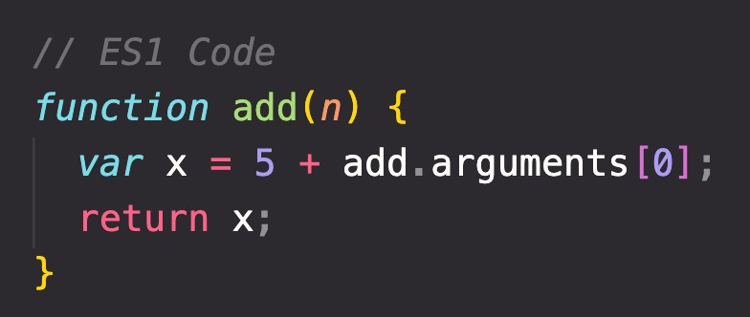



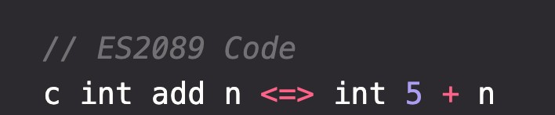

BACKWARDS COMPATIBILITY: DON’T BREAK THE WEB!
Modern JavaScript Engine
BACKWARDS COMPATIBLE
1997
2020
Old features are never removed; Not really new versions, just
incremental updates (releases)
Websites keep working forever!
DON’T BREAK THE WEB!
Modern JavaScript Engine
NOT FORWARDS COMPATIBLE
2020
2089

Slide 20
Queries?

Slide 21
FUNCTIONS CALLING OTHER FUNCTIONS

Slide 22
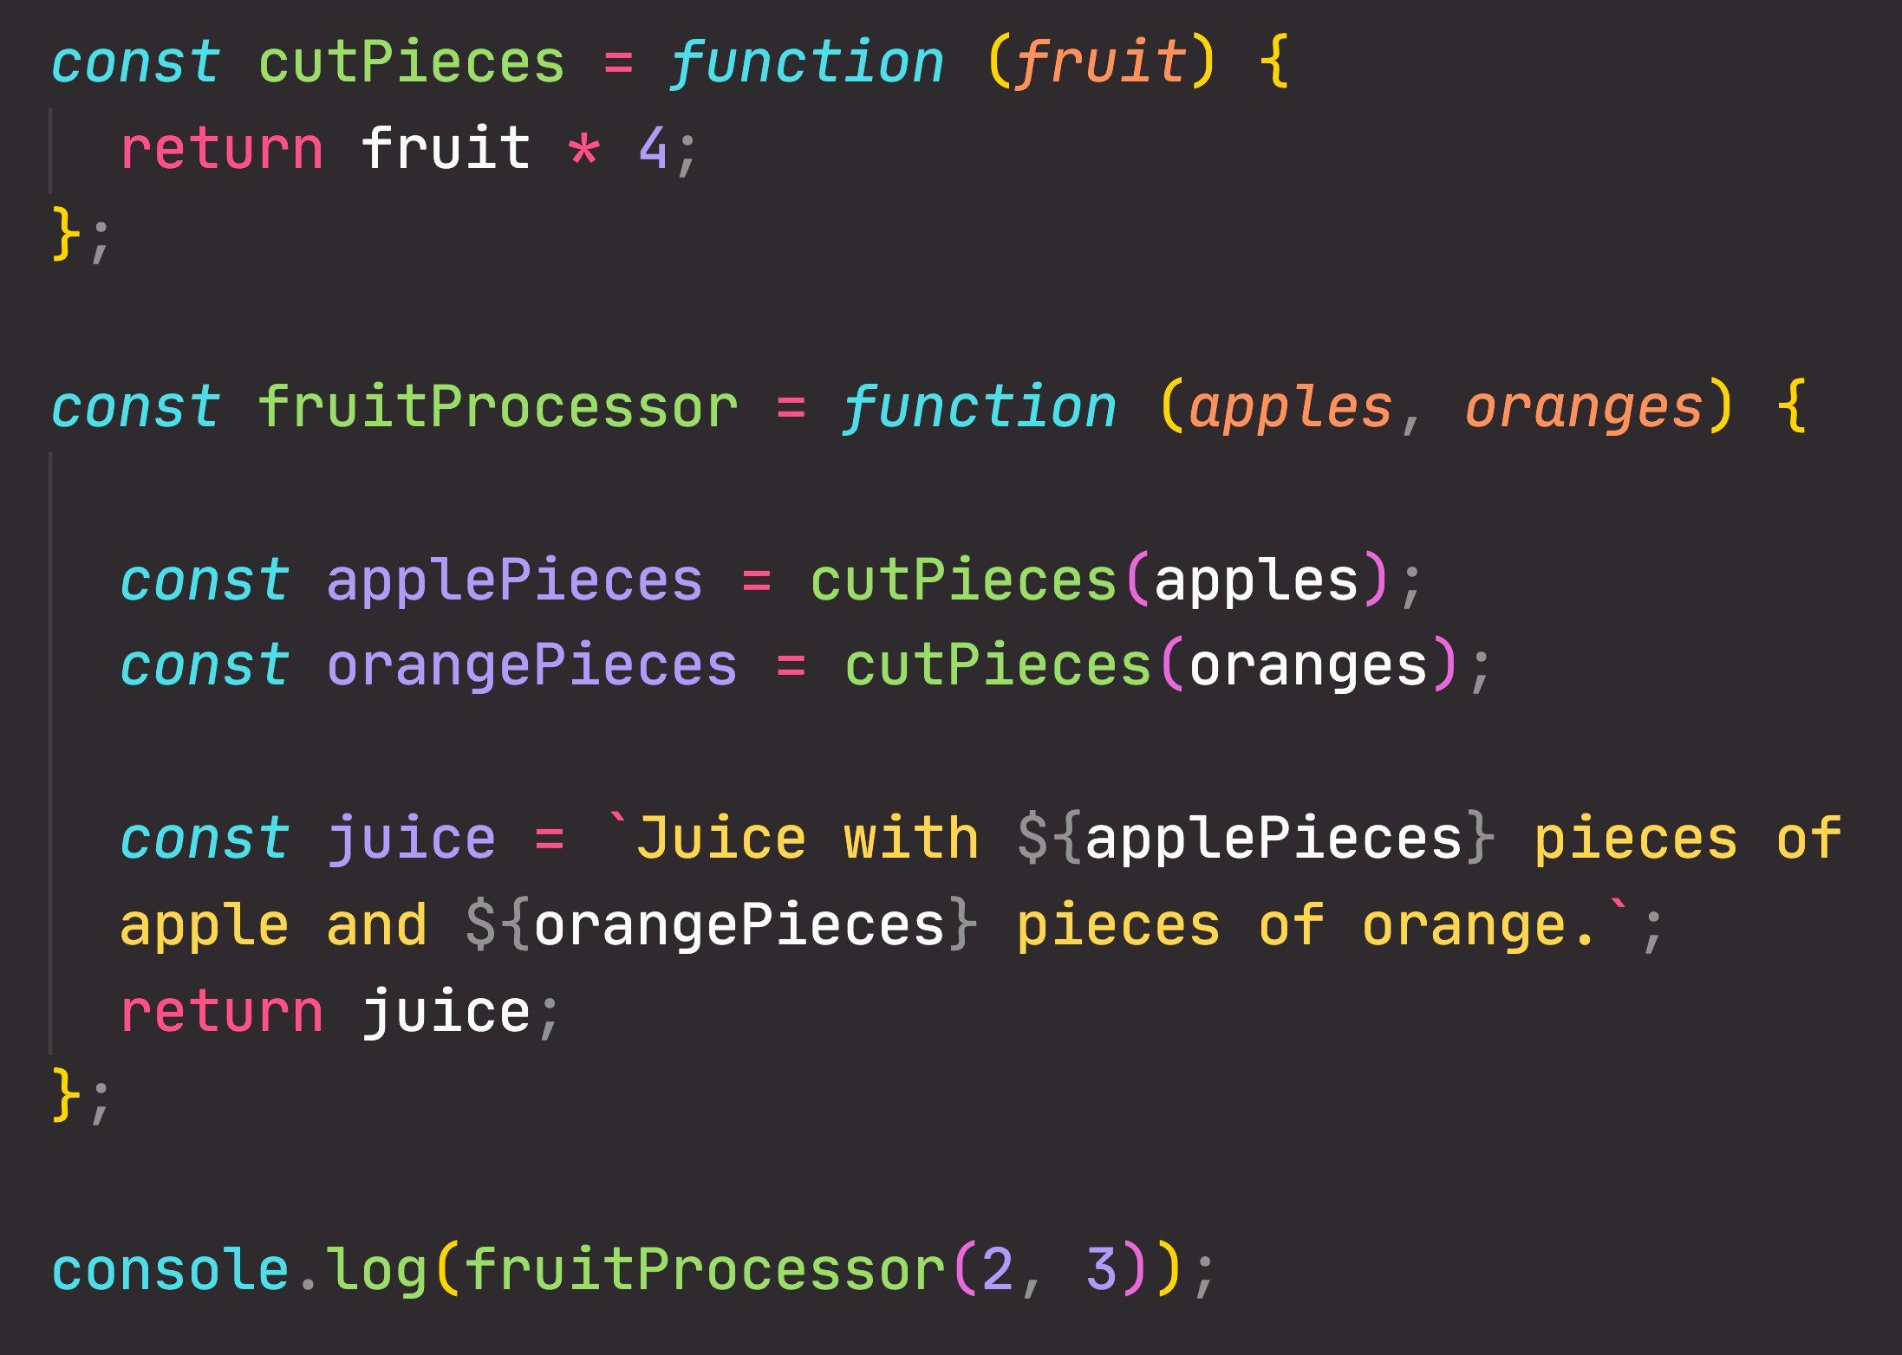

CALLING A FUNCTION INSIDE A FUNCTION: DATA FLOW
2
2
8
2
8
3
8
2

Slide 23
REVIEWING FUNCTIONS

Slide 24
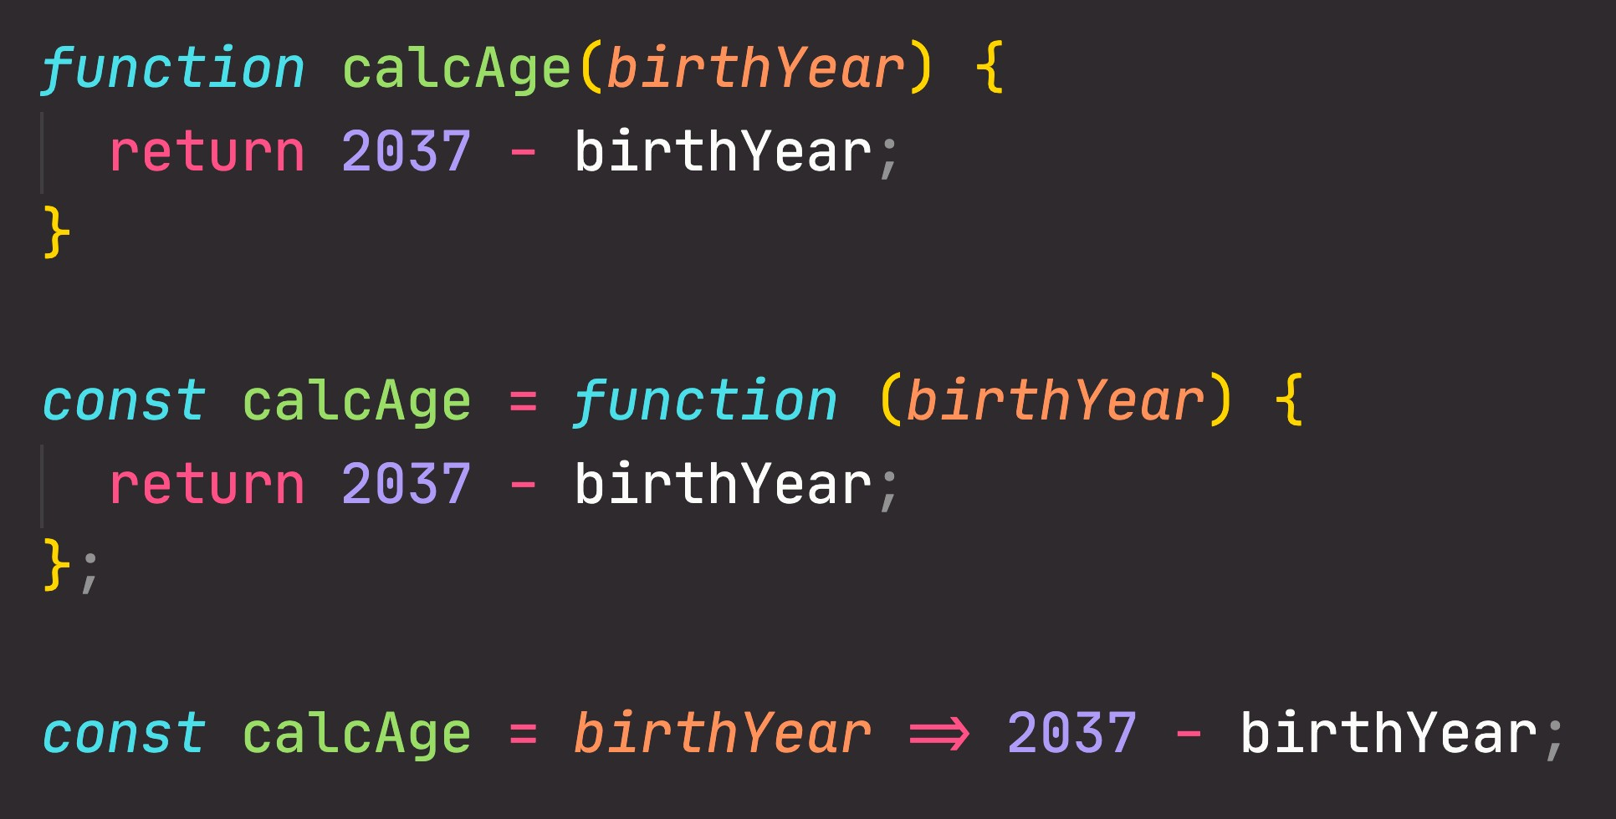
FUNCTIONS REVIEW; 3 DIFFERENT FUNCTION TYPES
Function declaration
Function that can be used before it’s declared
Function expression
Essentially a function
value stored in a variable
Arrow function
Great for a quick one-line functions. Has no this keyword (more later...)
Three different ways of writing functions, but they all work in a similar way: receive input data, transform data, and then output data.

Slide 25
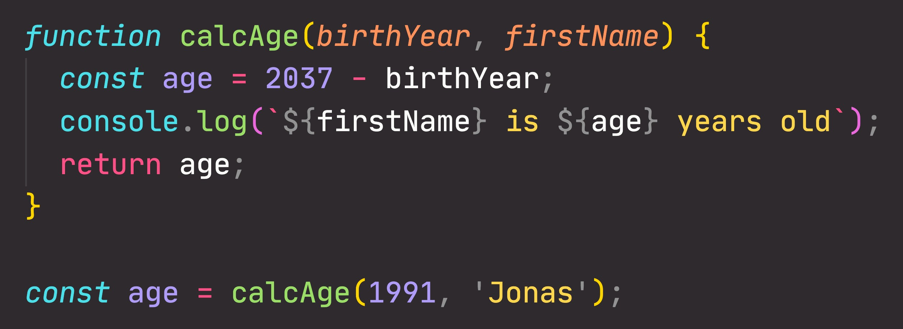
FUNCTIONS REVIEW: ANATOMY OF A FUNCTION
Parameters: placeholders to receive input
values. Like local variables of a function
Function body: block of code that we want to reuse. Processes the function’s input data
Function name
return statement to output a value from the function and terminate execution
Calling, running or invoking the function, using ()
Variable to save returned value (function output)
Arguments: actual values of function parameters, to input data

Slide 26
Queries?

Slide 27
WHAT'S THE DOM AND DOM MANIPULATION

Slide 28

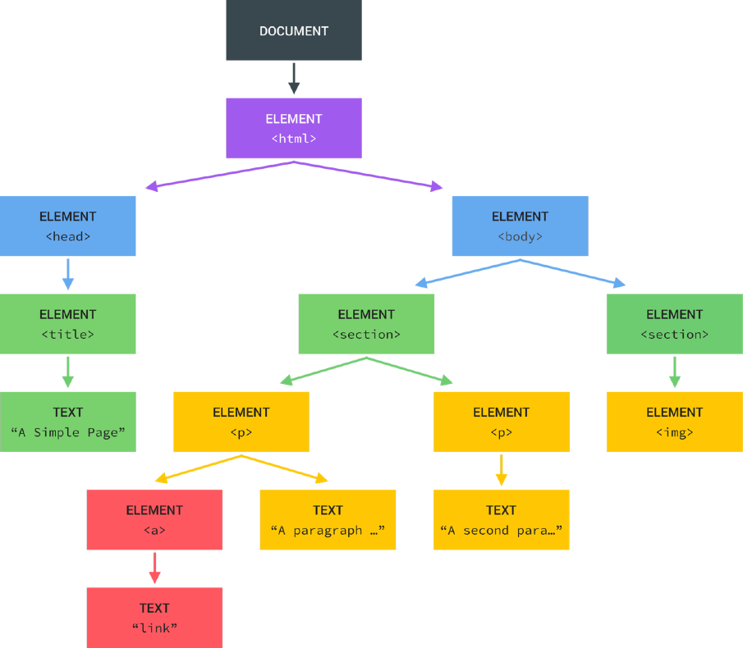
WHAT IS THE DOM?
Tree structure, generated by browser on HTML load
DOM
DOCUMENT OBJECT MODEL: STRUCTURED REPRESENTATION OF HTML DOCUMENTS. ALLOWS JAVASCRIPT TO ACCESS HTML ELEMENTS AND STYLES TO MANIPULATE THEM.
Change text, HTML attributes, and even CSS styles

Slide 29
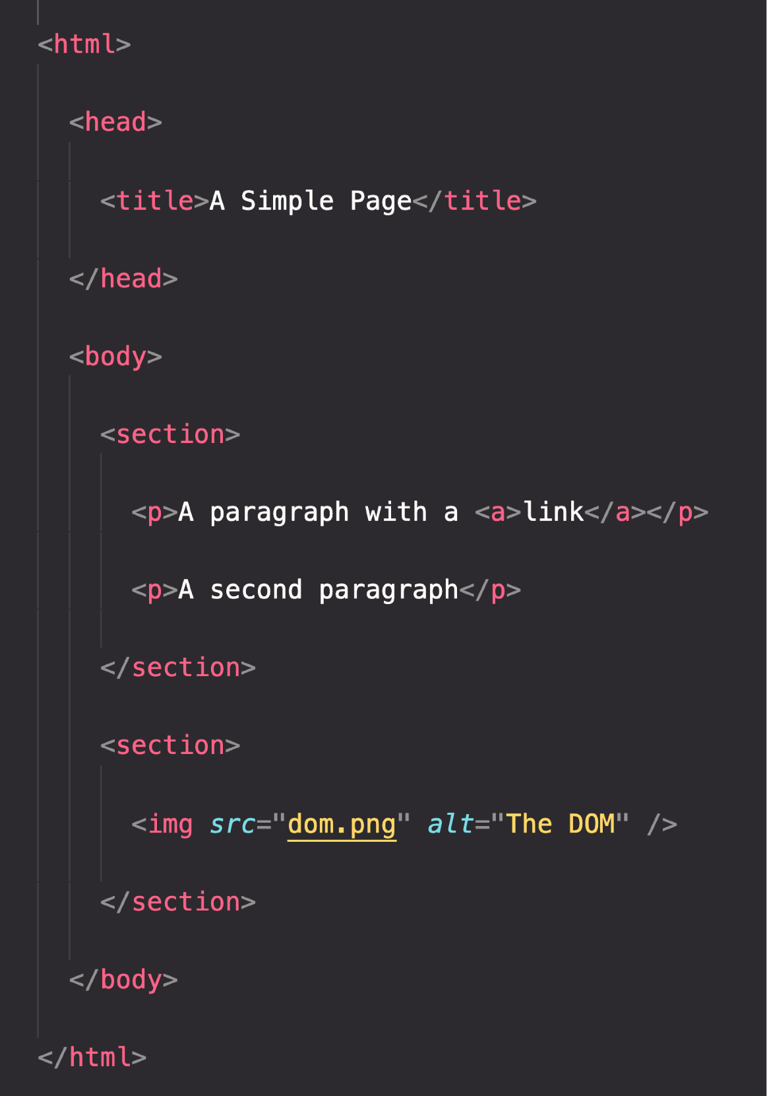

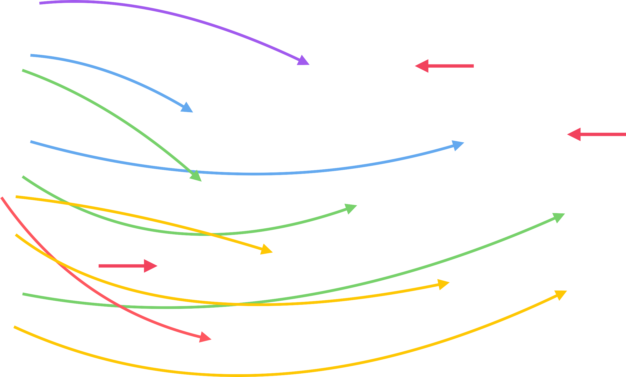
THE DOM TREE STRUCTURE
Special object that is the entry point to the DOM. Example: document.querySelector()

Slide 30

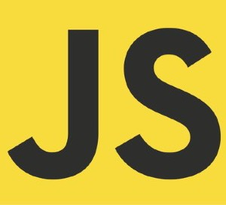




DOM ! ==JAVASCRIPT
DOM Methods and Properties for DOM Manipulation
NOT PART OF
For example
document.querySelector()
API: Application Programming Interface
WEB APIs
DOM Methods and Properties
Timers
CAN INTERACT WITH
Fetch

Slide 31
Queries?

Slide 32
AN HIGH-LEVEL OVERVIEW OF JAVASCRIPT

Slide 33
WHAT IS JAVASCRIPT: REVISITED
JAVASCRIPT
JAVASCRIPT IS A HIGH-LEVEL, OBJECT-ORIENTED, MULTI-PARADIGM PROGRAMMING LANGUAGE.

Slide 34


WHAT IS JAVASCRIPT: REVISITED
JAVASCRIPT
JAVASCRIPT IS A HIGH-LEVEL, PROTOTYPE-BASED OBJECT-ORIENTED, MULTI-PARADIGM, INTERPRETED OR JUST-IN-TIME COMPILED,
DYNAMIC, SINGLE-THREADED,
GARBAGE-COLLECTED
PROGRAMMING
LANGUAGE WITH
FIRST-CLASS FUNCTIONS
AND A NON-BLOCKING
EVENT LOOP CONCURRENCY MODEL.

Slide 35
DECONSTRUCTING THE MONSTER DEFINITION
High-level
Garbage-collected
Interpreted or just-in-time compiled
Multi-paradigm
Prototype-based object-oriented
First-class functions
Dynamic
Single-threaded
Non-blocking event loop

Slide 36


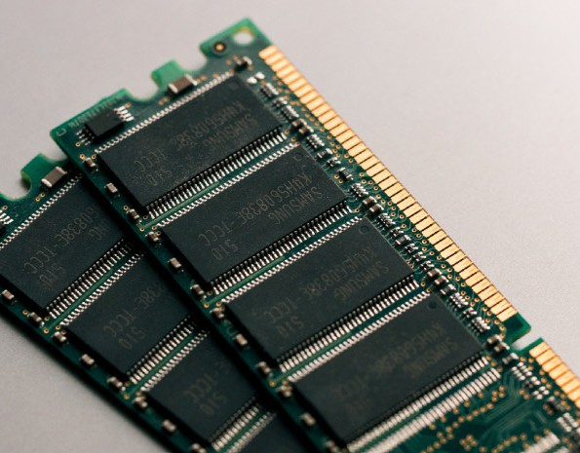



DECONSTRUCTING THE MONSTER DEFINITION
High-level
Any computer program needs resources:
Garbage-collected
Interpreted or just-in-time compiled
+
Multi-paradigm
Prototype-based object-oriented
First-class functions
Dynamic
LOW-LEVEL
HIGH-LEVEL
Single-threaded
Developer has to manage resources manually
Developer does NOT have to worry, everything happens automatically
Non-blocking event loop

Slide 37


DECONSTRUCTING THE MONSTER DEFINITION
High-level
Garbage-collected
Interpreted or just-in-time compiled
Multi-paradigm
Cleaning the memory so we don’t have to
Prototype-based object-oriented
First-class functions
Dynamic
Single-threaded
Non-blocking event loop

Slide 38

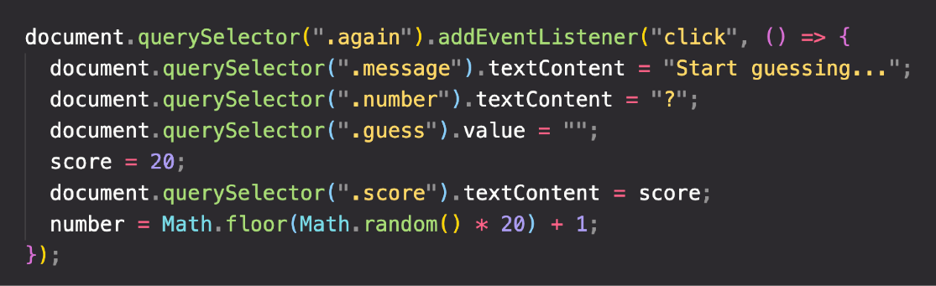

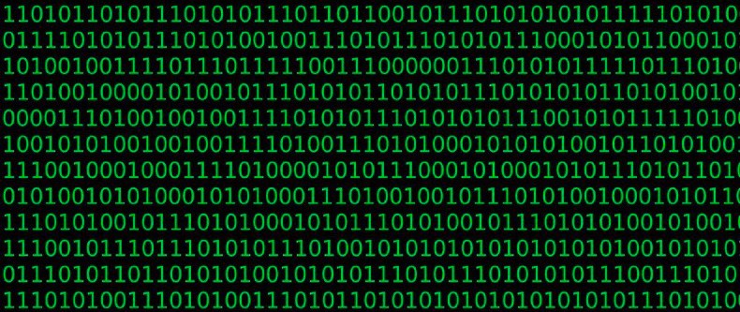
DECONSTRUCTING THE MONSTER DEFINITION
High-level
Garbage-collected
Abstraction over 0s and 1s
Interpreted or just-in-time compiled
Multi-paradigm
CONVERT TO MACHINE CODE = COMPILING
Prototype-based object-oriented
Happens inside the JavaScript engine
First-class functions
Dynamic
Single-threaded
More about this Later in this Section
Non-blocking event loop

Slide 39

DECONSTRUCTING THE MONSTER DEFINITION
High-level
Paradigm: An approach and mindset of structuring code, which will direct your coding style and technique.
Garbage-collected
Interpreted or just-in-time compiled
The one we’ve been using so far
Multi-paradigm
1 Procedural programming
Imperative vs.
Declarative
2
Object-oriented programming (OOP)
Prototype-based object-oriented
3
Functional programming (FP)
First-class functions
Dynamic
Single-threaded
More about this later in Multiple Sections
Non-blocking event loop

Slide 40
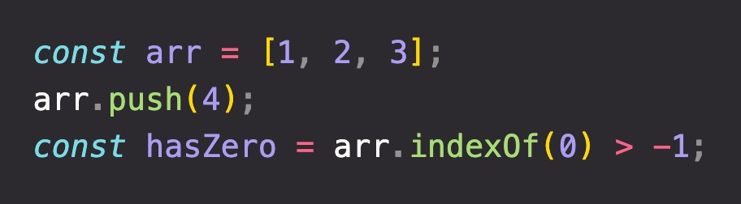
DECONSTRUCTING THE MONSTER DEFINITION
High-level
Prototype
Garbage-collected
Array
Array.prototype.push
(Oversimplification!)
Interpreted or just-in-time compiled
Array.prototype.indexOf
Multi-paradigm
Our array inherits methods from prototype
Built from prototype
Prototype-based object-oriented
First-class functions
Dynamic
Single-threaded
More about this in Section Object Oriented Programming
Non-blocking event loop

Slide 41

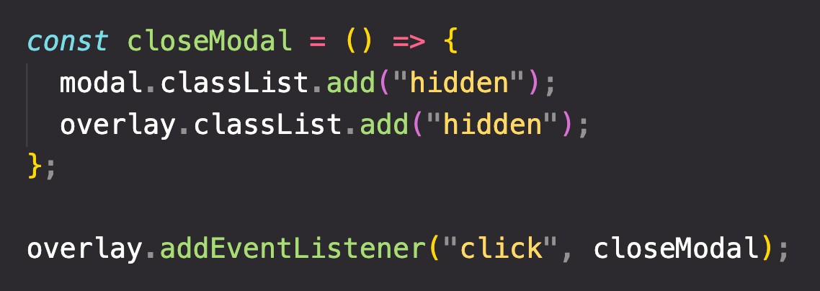
DECONSTRUCTING THE MONSTER DEFINITION
High-level
In a language with first-class functions, functions are simply treated as variables. We can pass them into other functions, and return them from functions.
Garbage-collected
Interpreted or just-in-time compiled
Multi-paradigm
Passing a function into another function as an argument:
First-class functions!
Prototype-based object-oriented
First-class functions
Dynamic
Single-threaded
More about this in Section A Closer Look at Functions
Non-blocking event loop

Slide 42

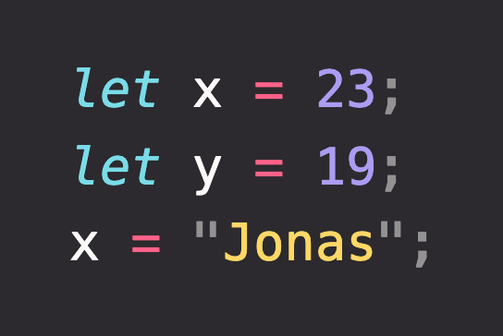



DECONSTRUCTING THE MONSTER DEFINITION
High-level
Garbage-collected
Dynamically-typed language:
Interpreted or just-in-time compiled
No data type definitions. Types becomes known at runtime
Multi-paradigm
Prototype-based object-oriented
Data type of variable is automatically changed
First-class functions
Dynamic
Single-threaded
Non-blocking event loop

Slide 43
DECONSTRUCTING THE MONSTER DEFINITION
High-level
Concurrency model: how the JavaScript engine handles multiple tasks happening at the same time.
Garbage-collected
Why do we need that?
Interpreted or just-in-time compiled
JavaScript runs in one single thread, so it can only do one thing at a time.
Multi-paradigm
So what about a long-running task?
Sounds like it would block the single thread. However, we want non-blocking behavior!
Prototype-based object-oriented
First-class functions
How do we achieve that?
(Oversimplification!)
Dynamic
By using an event loop: takes long running tasks, executes them in the “background”, and puts them back in the main thread once they are finished.
Single-threaded
More about this Later in this Section
Non-blocking event loop

Slide 44
Queries?

Slide 45
THE JAVASCRIPT ENGINE AND RUNTIME

Slide 46



WHAT IS A JAVASCRIPT ENGINE?
JS ENGINE
ENGINE
PROGRAM THAT EXECUTES
JAVASCRIPT CODE.
Object in memory
Execution context
Example: V8 Engine
CALL STACK
HEAP
How is it compiled?
our code is executed
Where objects are stored
Where

Slide 47


COMPUTER SCIENCE SIDENOTE: COMPILATION VS. INTERPRETATION
Compilation: Entire code is converted into machine code at once, and written to a binary file that can be executed by a computer.
Source code
STEP 1
Portable file:
machine code
STEP 2
Program running
COMPILATION
EXECUTION
Can happen way after compilation
Interpretation: Interpreter runs through the source code and executes it line by line.
Source code
STEP 1
Program running
EXECUTION LINE BY LINE
Code still needs to be converted to machine code
Just-in-time (JIT) compilation: Entire code is converted into machine code at once, then executed immediately.
Source code
STEP 1
Machine code
STEP 2
Program running
COMPILATION
EXECUTION
NOT a portable file
Happens immediately

Slide 48
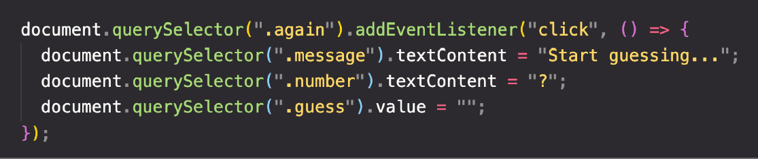
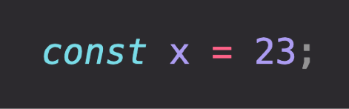
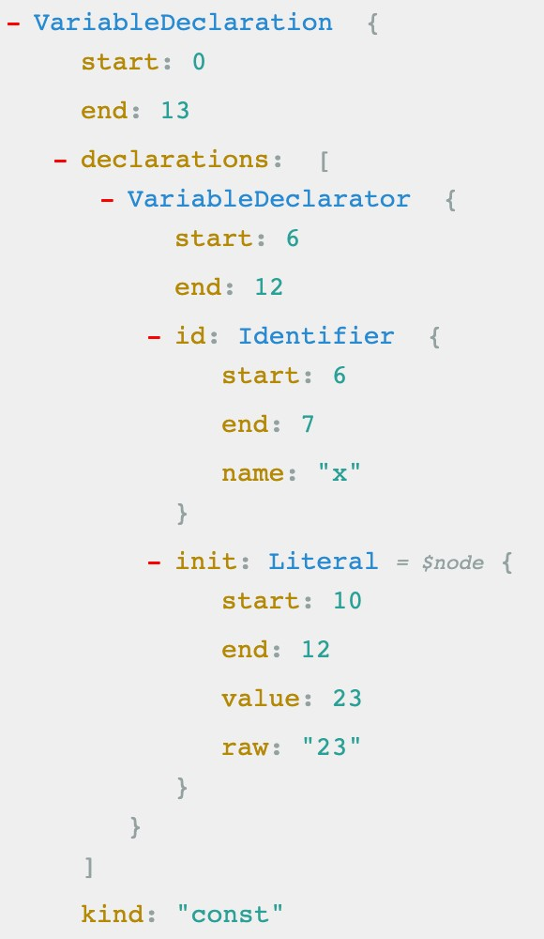


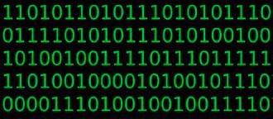

MODERN JUST-IN-TIME COMPILATION OF JAVASCRIPT
“JavaScript is an interpreted language”
ENGINE
AST Example
Happens in special threads that we can’t
Parsing
Example
access from code
AST
Compilation
Just-in-time compilation
Optimization
Execution
Happens in Call Stack
During execution!

Slide 49


THE BIGGER PICTURE: JAVASCRIPT RUNTIME
RUNTIME IN THE BROWSER
Functionalities provided to
Container including all the things
the engine, accessible on
ENGINE
that we need to use Jav_{W}aS_{E}cr_{B}ipt_{APIs}
window object
(in this case in the browser)
DOM
Timers
...
Fetch API
EVENT LOOP
Essential for non-blocking concurrency model
CALLBACK QUEUE
click
timer
data
...
onClick
HEAP
CALL STACK
Example: Callback function from DOM event listener

Slide 50
THE BIGGER PICTURE: JAVASCRIPT RUNTIME
RUNTIME IN NODE.JS
WEB APIs
C++ BINDINGS & THREAD POOL
ENGINE
EVENT LOOP
CALLBACK QUEUE
click
timer
data
...
HEAP
CALL STACK

Slide 51
Queries?

Slide 52
EXECUTION CONTEXTS AND THE CALL STACK

Slide 53

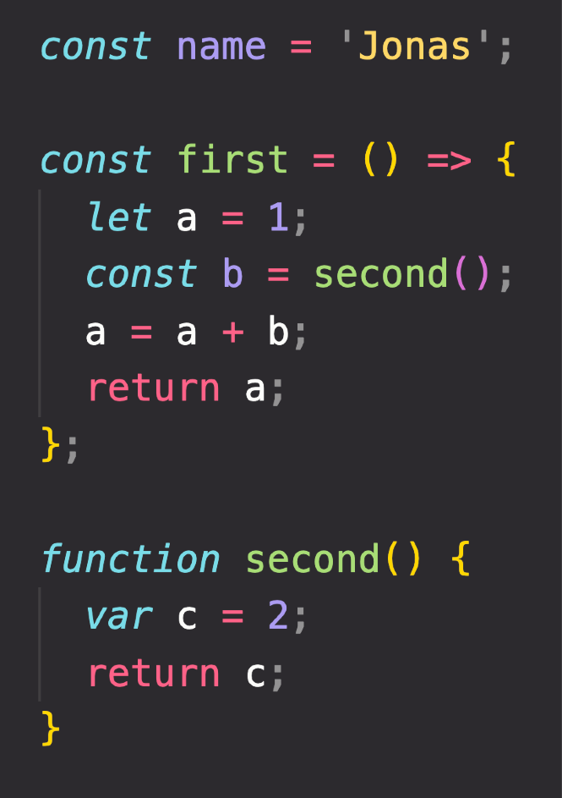



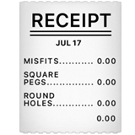


WHAT IS AN EXECUTION CONTEXT?
Compilation
EXECUTION CONTEXT
Human-readable code:
Environment in which a piece of JavaScript is executed. Stores all the necessary information for some code to be executed.
“JavaScript code"
+ +
Pizza “execution context”
Creation of global execution context (for top-level code)
NOT inside a function
EXECUTION
Execution of top-level code
(inside global EC)
Exactly one global execution context (EC): Default context, created for code that is not inside any function (top-level).
Function body only executed when called!
Execution of functions and waiting for callbacks
One execution context per function: For each function call, a new execution context is created.
All together make the call stack
Example: click event callback

Slide 54
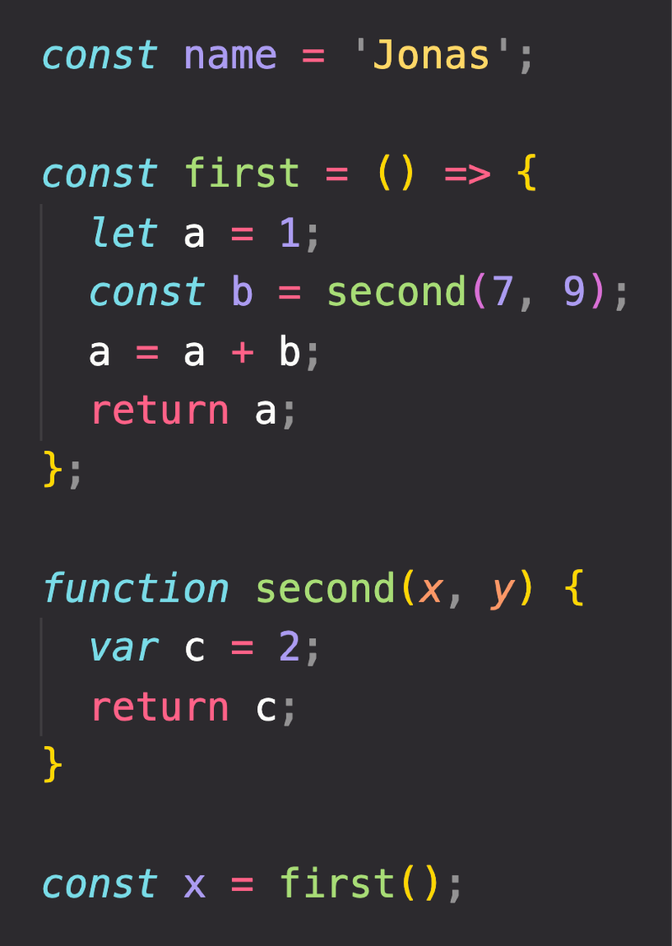
EXECUTION CONTEXT IN DETAIL
Global
name = ‘Jonas’ first = <function> second = <function> x = <unknown>
Literally the function code
WHAT’S INSIDE EXECUTION CONTEXT?
1
Variable Environment
let, const and var declarations Functions
arguments object
Need to run
first() first
first()
a = 1
b = <unknown>
Need to run
second() first
2
Scope chain
NOT in arrow functions!
3
this keyword
second()
c = 2
arguments = [7, 9]
Generated during “creation phase”, right before execution
Array of passed arguments. Available in all “regular” functions (not arrow)
(Technically, values only become known during execution)

Slide 55
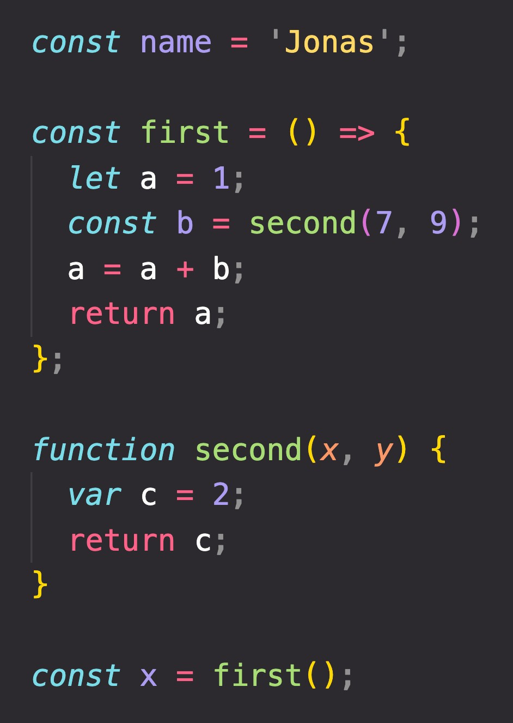


THE CALL STACK
Compiled code starts execution
second()
first()
ENGINE
Global
“Place” where execution contexts get
CALL STACK
stacked on top of each other, to keep
track of where we are in the execution

Slide 56
Queries?

Slide 57
SCOPE AND THE SCOPE CHAIN

Slide 58



SCOPING AND SCOPE IN JAVASCRIPT: CONCEPTS
EXECUTION CONTEXT
Variable environment
this keyword
Scope chain
SCOPE CONCEPTS
Scoping: How our program’s variables are organized and accessed. “Where do variables live?” or “Where can we access a certain variable, and where not?”;
Lexical scoping: Scoping is controlled by placement of functions and blocks in the code;
Scope: Space or environment in which a certain variable is declared (variable environment in case of functions). There is global scope, function scope, and block scope;
Scope of a variable: Region of our code where a certain variable can be accessed.

Slide 59
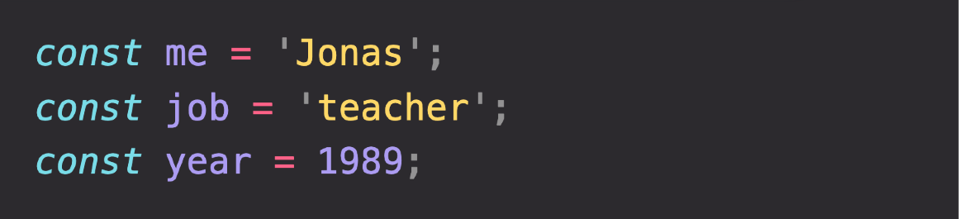
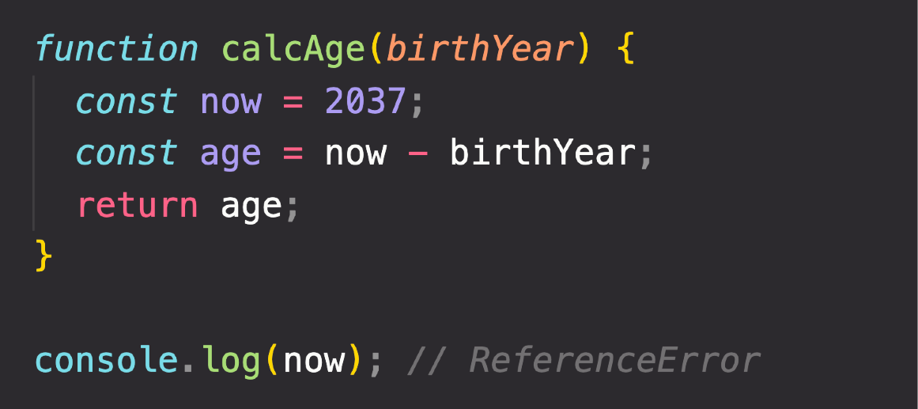
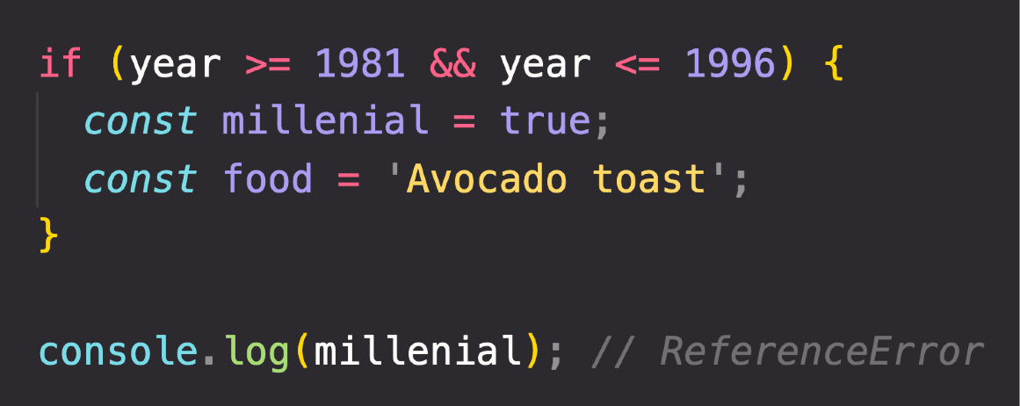

THE 3 TYPES OF SCOPE
GLOBAL SCOPE
FUNCTION SCOPE
BLOCK SCOPE (ES6)
Example: if block, for loop block, etc.
Outside of any function or block
Variables declared in global scope are accessible everywhere
Variables are accessible only
inside function, NOT outside
Also called local scope
Variables are accessible only
inside block (block scoped)
HOWEVER, this only applies to
let and const variables!
Functions are also block scoped
(only in strict mode)

Slide 60
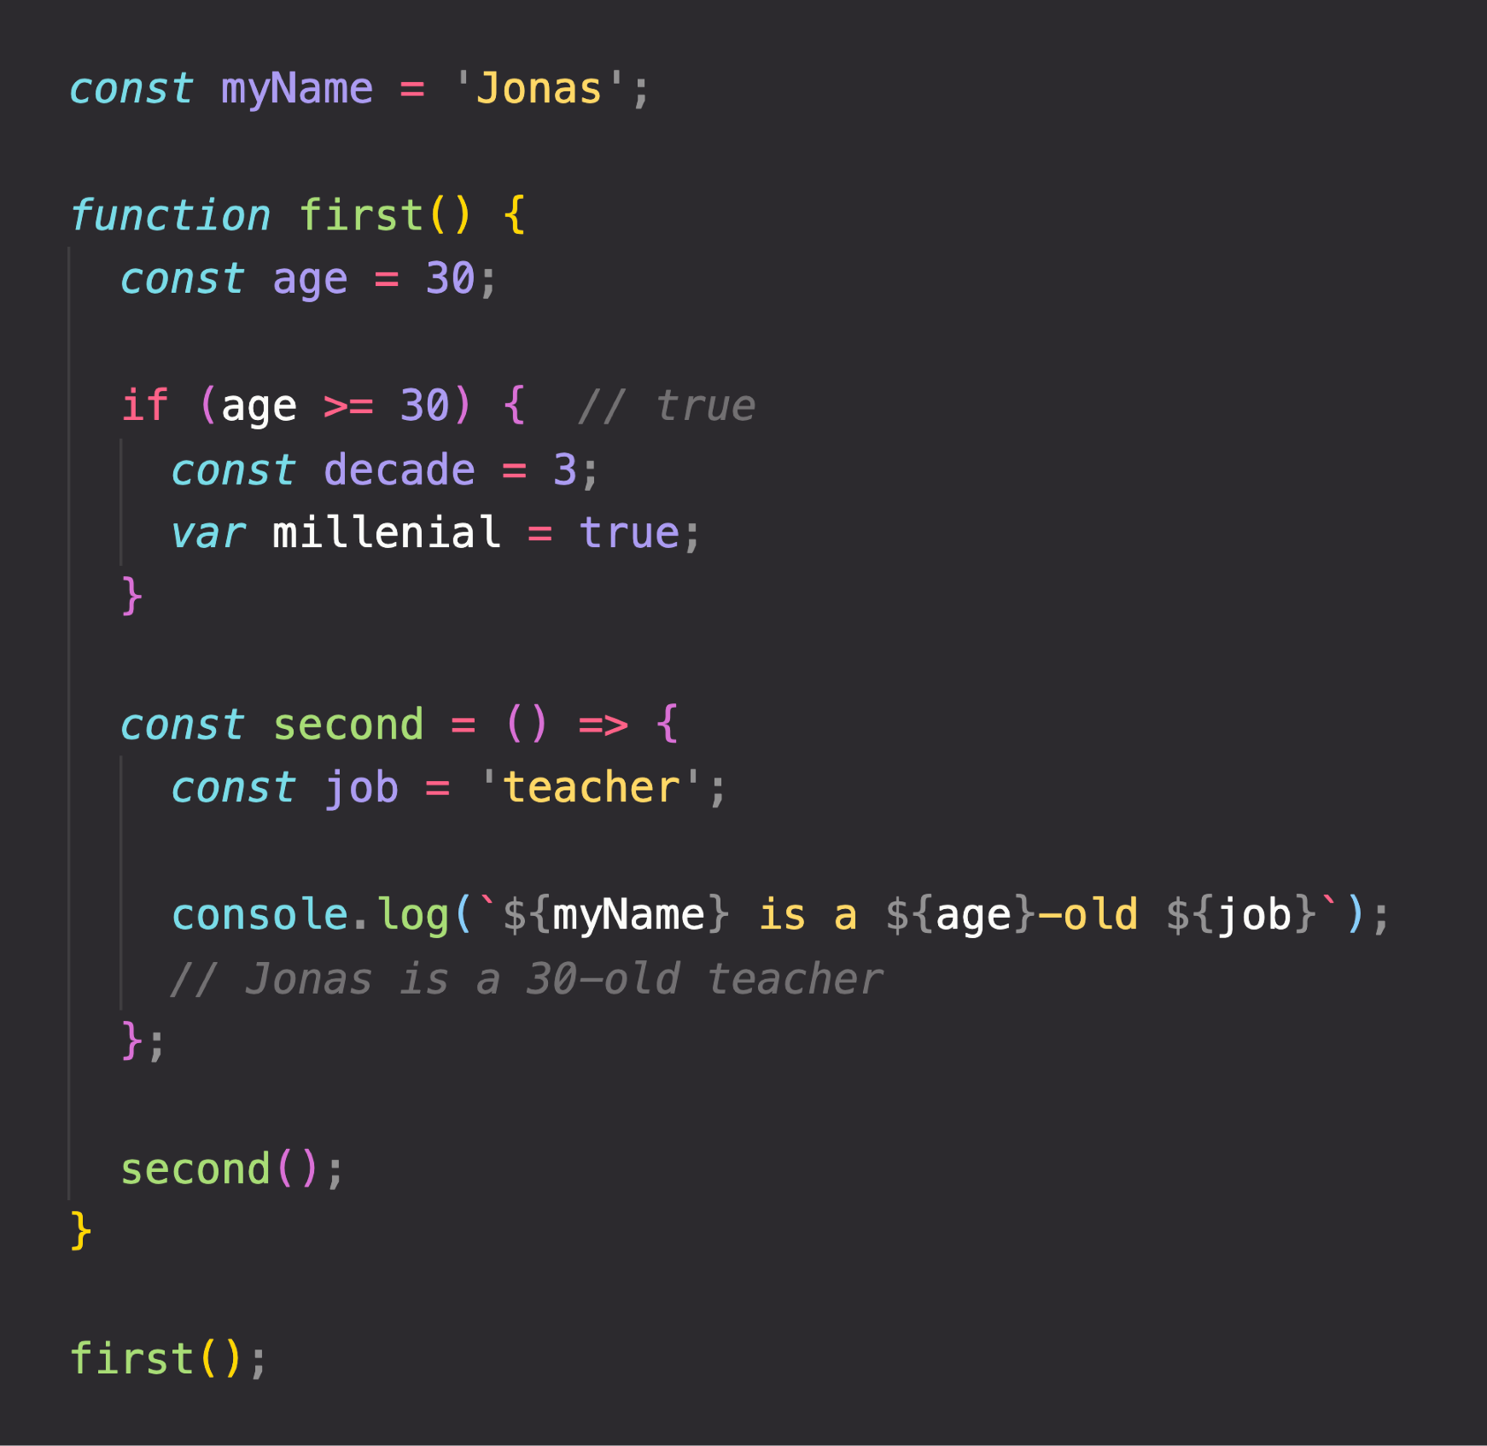


THE SCOPE CHAIN
(Considering only variable declarations)
Global scope
myName = “Jonas”
Global variable
CHAIN
SCOPE CHAIN
let and const are block-scoped
SCOPE
first() scope
age = 30
millennial = true
Variables not in current scope
var is function-scoped
IN
myName = “Jonas”
Scope has access to variables from all outer scopes
LOOKUP
VARIABLE
if block scope
decade = 3
second() scope
job = “teacher”
age = 30
millennial = true
age = 30
millennial = true
myName = “Jonas”
myName = “Jonas”

Slide 61
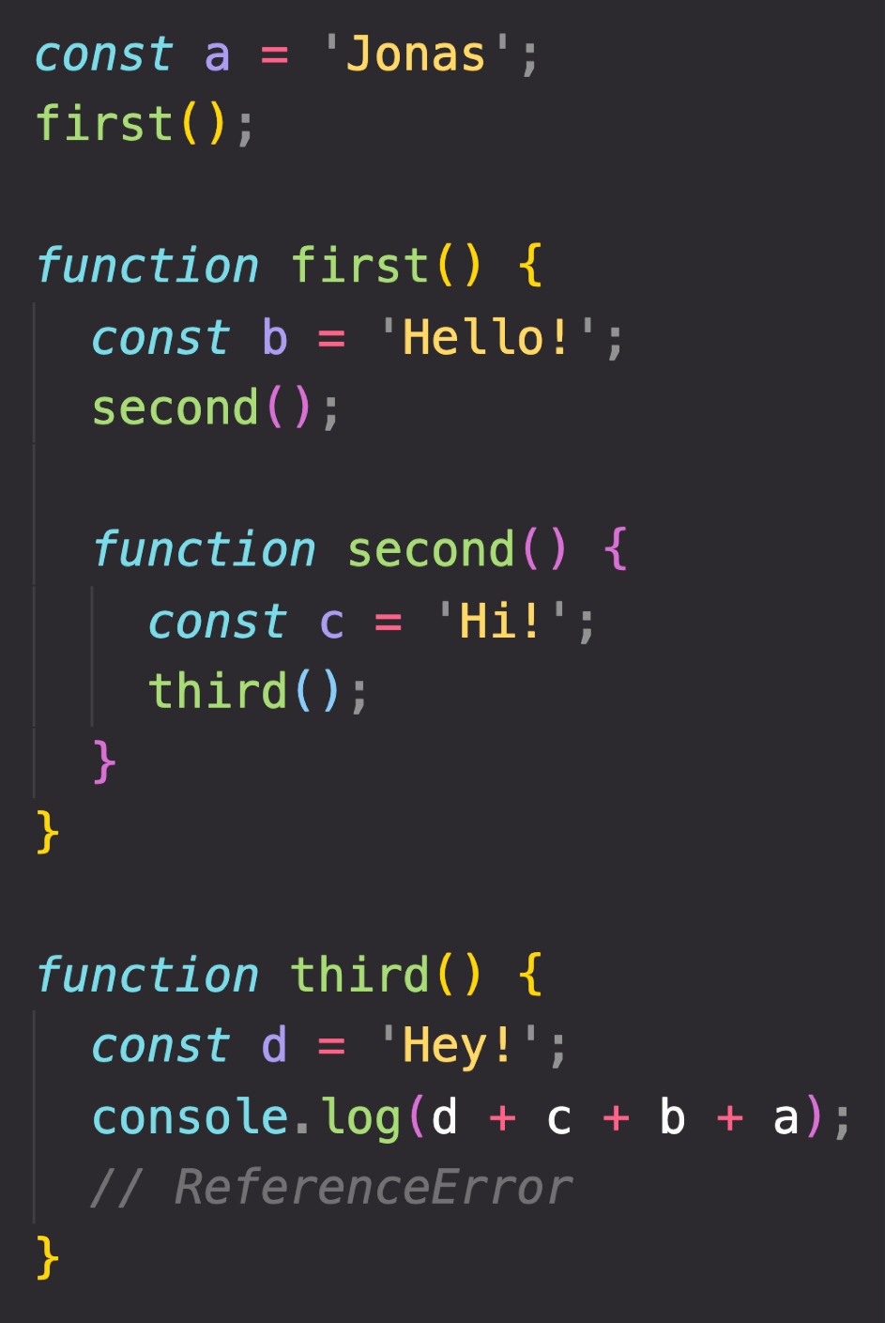
SCOPE CHAIN VS. CALL STACK
Global scope
a = “Jonas”
first = <function>
third = <function>
third() EC
d = “Hey!”
second() EC
first() scope
b = “Hello!” second = <function>
a = “Jonas” first = <function> third = <function>
third() scope
d = “Hey!”
a = “Jonas” first = <function> third = <function>
c = “Hi!”
first() EC
b = “Hello!”
second = <function>
SCOPE CHAIN
Order in which functions are written in the code
Global EC
second() scope
c = “Hi!”
b = “Hello!” second = <function>
a = “Jonas” first = <function> third = <function>
a = “Jonas”
first = <function>
third = <function>
CALL STACK
Order in which functions were called
Has nothing to do with order in which functions were called!
c and b can NOT be found in third() scope!
Variable environment (VE)

Slide 62
SUMMARY
Scoping asks the question “Where do variables live?” or “Where can we access a certain variable, and where not?”;
There are 3 types of scope in JavaScript: the global scope, scopes defined by functions, and scopes defined by blocks; Only let and const variables are block-scoped. Variables declared with var end up in the closest function scope;
In JavaScript, we have lexical scoping, so the rules of where we can access variables are based on exactly where in the code functions and blocks are written;
Every scope always has access to all the variables from all its outer scopes. This is the scope chain!
When a variable is not in the current scope, the engine looks up in the scope chain until it finds the variable it’s looking for. This is called variable lookup;
The scope chain is a one-way street: a scope will never, ever have access to the variables of an inner scope;
The scope chain in a certain scope is equal to adding together all the variable environments of the all parent scopes;
The scope chain has nothing to do with the order in which functions were called. It does not affect the scope chain at all!

Slide 63
Queries?

Slide 64
VARIABLE ENVIRONMENT: HOISTING AND THE TDZ

Slide 65



HOISTING IN JAVASCRIPT
Hoisting: Makes some types of variables accessible/usable in the code before they are actually declared. “Variables lifted to the top of their scope”.
EXECUTION CONTEXT
Scope chain
this keyword
Variable environment
BEHIND THE SCENES
Before execution, code is scanned for variable declarations, and for each variable, a new property is created in the variable environment object.
HOISTED?
INITIAL VALUE
SCOPE
In strict mode.
Otherwise: function!
function declarations
YES
Actual function
Block
var variables
YES
undefined
Function
Technically, yes. But not in practice
let and const variables
NO
<uninitialized>, TDZ
Block
function expressions and arrows
Depends if using var or let/const
Temporal Dead Zone

Slide 66
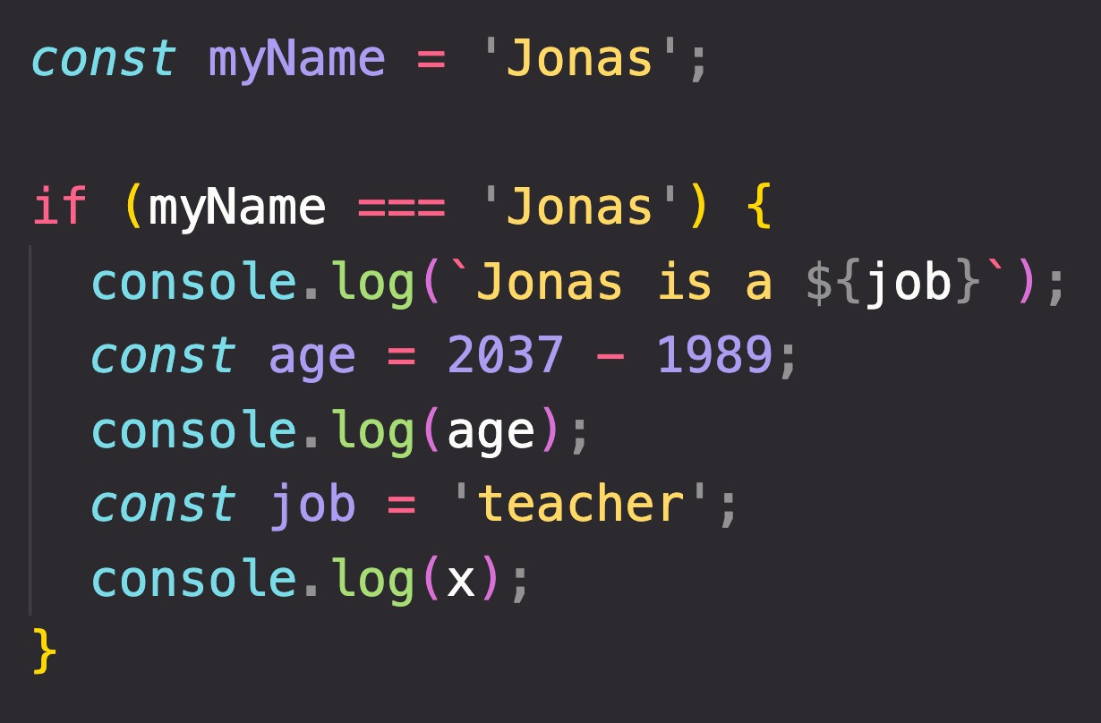
TEMPORAL DEAD ZONE, LET AND CONST
TEMPORAL DEAD ZONE FOR job VARIABLE
Different kinds of error messages:
ReferenceError: Cannot access 'job' before initialization ReferenceError: x is not defined
WHY HOISTING?
WHY TDZ?
Using functions before actual declaration;
var hoisting is just a byproduct.
Makes it easier to avoid and catch errors: accessing variables before declaration is bad practice and should be avoided;
Makes const variables actually work

Slide 67
THE THIS KEYWORD

Slide 68
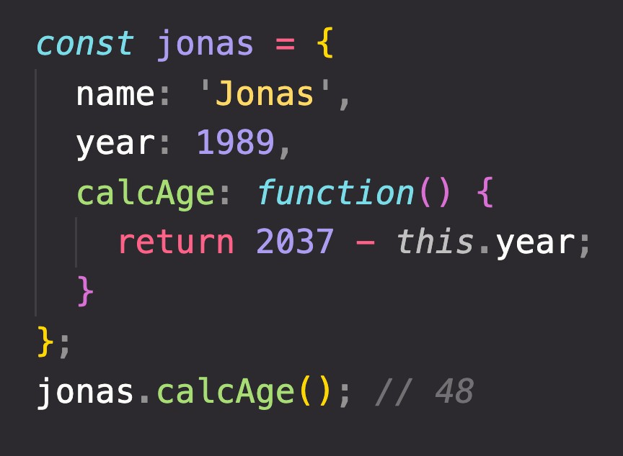

HOW THE THIS KEYWORD WORKS
this keyword/variable: Special variable that is created for every execution context (every function). Takes the value of (points to) the “owner” of the function in which the this keyword is used.
EXECUTION CONTEXT
Variable environment Scope chain
this is NOT static. It depends on how the function is called, and its value is only assigned when the function is actually called.
this keyword
Method example:
Method this = <Object that is calling the method>
Simple function call this = undefined
In strict mode! Otherwise:
window (in the browser)
Don’t get own this
Arrow functions this = <this of surrounding function (lexical this)>
Event listener this = <DOM element that the handler is attached to>
new, call, apply, bind <Later in the course... >
calcAge
is method
jonas
1989
this does NOT point to the function itself, and also NOT the its variable environment!
Way better than using
jonas.year!

Slide 69
Queries?

Slide 70
PRIMITIVES VS. OBJECTS (PRIMITIVE VS. REFERENCE TYPES)

Slide 71
REVIEW: PRIMITIVES, OBJECTS AND THE JAVASCRIPT ENGINE
PRIMITIVES
Number String Boolean Undefined Null Symbol BigInt
OBJECTS
Object literal Arrays Functions Many more…
ENGINE
STORED IN
STORED IN
REFERENCE TYPES
CALL STACK
HEAP
PRIMITIVE TYPES

Slide 72
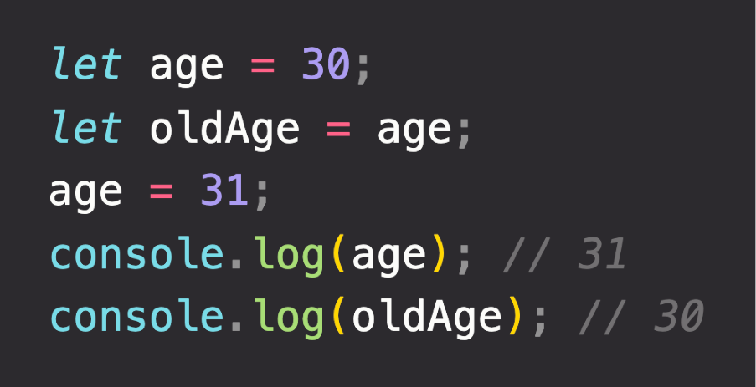


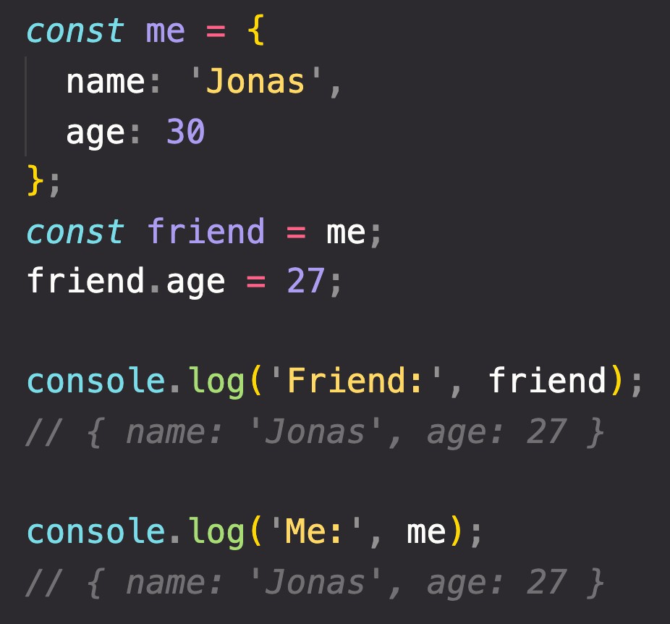
PRIMITIVE VS. REFERENCE VALUES
Primitive values example:
Identifier
Address
Value
Address
Value
age
0001
30 31
{
name: ‘Jonas’; age: 30;
}
D30F
Reference values example:
oldAge
0002
31
Reference to memory address in Heap
27
me
0003
D30F
No problem, because we’re NOT changing the value at address 0003!
friend
CALL STACK
HEAP

Slide 73
“HOW JAVASCRIPT WORKS BEHIND THE SCENES” TOPICS FOR LATER...
1
Prototypal Inheritance
Object Oriented Programming (OOP) With JavaScript
2
Event Loop
Asynchronous JavaScript: Promises, Async/Await and AJAX
3
How the DOM Really Works
Advanced DOM and Events

Slide 74
SUMMARY: WHICH DATA STRUCTURE TO USE?

Slide 75
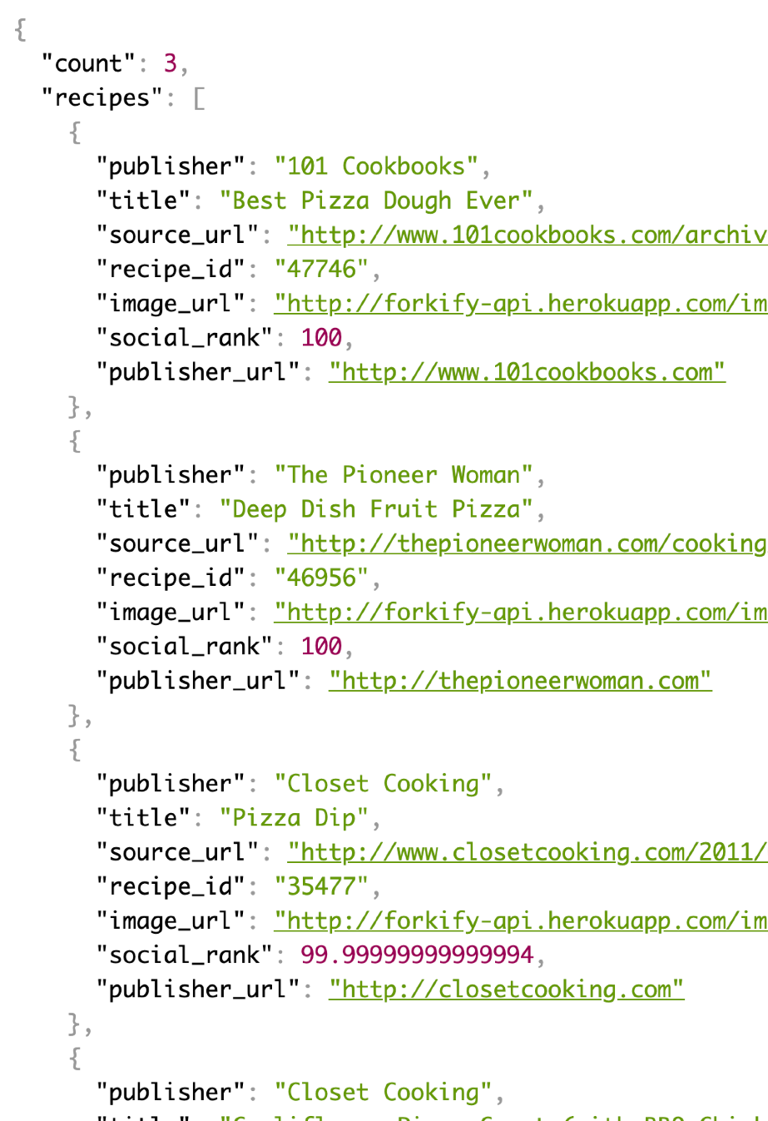
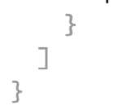

DATA STRUCTURES OVERVIEW
SOURCES OF DATA
From the program itself: Data written directly in source code (e.g. status messages)
From the UI: Data input from the user or data written in DOM (e.g tasks in todo app)
From external sources: Data fetched for example from web API (e.g. recipe objects)
“Object”
Array
Application Programming Interface
“Object”
Collection of data
OTHER BUILT-IN:
WeakMap WeakSet
NON-BUILT IN:
Stacks Queues Linked lists Trees
Hash tables
Data structure
SIMPLE LIST?
KEY/VALUE PAIRS?
Arrays or Sets
Objects or Maps
Keys allow us to
describe values
JSON data format example

Slide 76
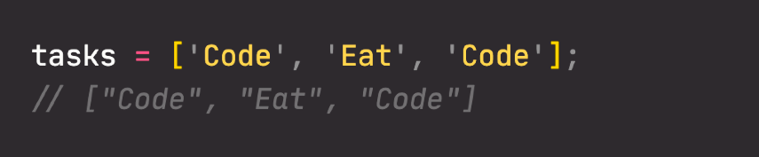
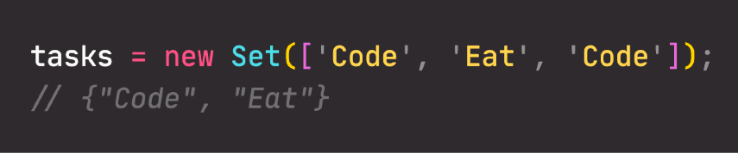
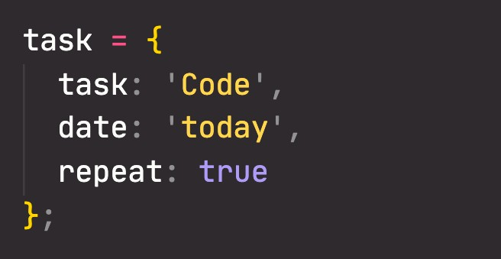
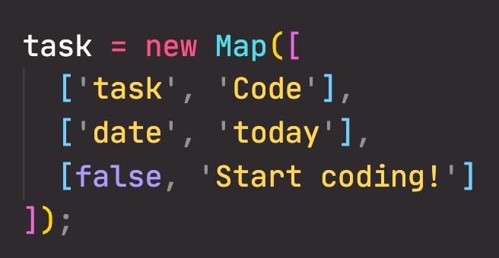
ARRAYS VS. SETS AND OBJECTS VS. MAPS
ARRAYS
VS.
SETS
OBJECTS
VS.
MAPS
Use when you need ordered list of values (might contain duplicates)
Use when you need to
manipulate data
Use when you need to work with unique values
Use when high-performance
is really important
Use to remove duplicates
from arrays
More “traditional” key/value store (“abused” objects)
Easier to write and access values with . and []
Better performance
Keys can have any data type Easy to iterate
Easy to compute size
Use when you need to include functions (methods)
Use when working with JSON (can convert to map)
Use when you simply need to map key to values
Use when you need keys that are not strings

Slide 77
Queries?

Slide 78
FIRST-CLASS AND HIGHER-ORDER FUNCTIONS

Slide 79
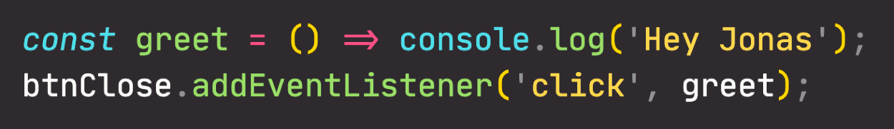
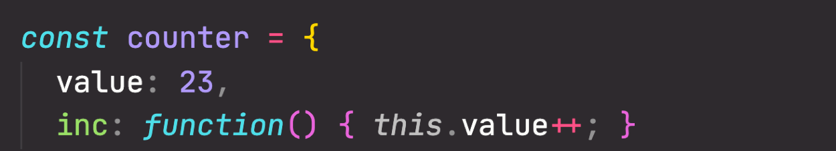


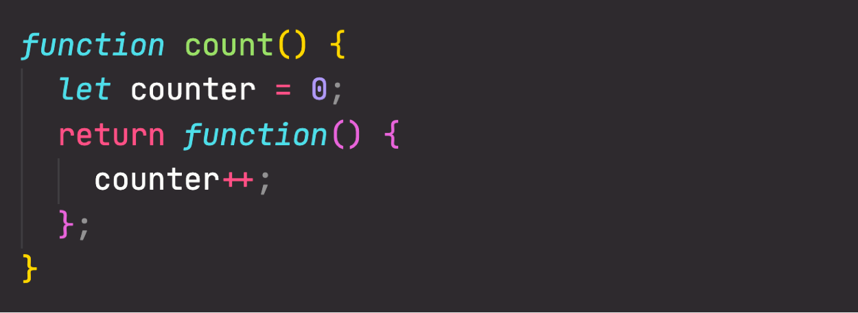

FIRST-CLASS VS. HIGHER-ORDER FUNCTIONS
FIRST-CLASS FUNCTIONS
HIGHER-ORDER FUNCTIONS
JavaScript treats functions as first-class citizens
This means that functions are simply values
Functions are just another “type” of object
Store functions in variables or properties:
A function that receives another function as an argument, that returns a new function, or both
This is only possible because of first-class functions
Function that receives another function
1
Higher-order function
Callback function
Pass functions as arguments to OTHER functions:
2
Function that returns new function
Higher-order function
Returned function
Return functions FROM functions
Call methods on functions:

Slide 80
END

